Slide 1
Cargill Philippines –
C-Joy Mobile App Development Proposal

Slide 2
Agenda
1
UNDERSTANDING & SCOPE
4
ASSUMPTIONS, DEPENDENCIES
2
TECHNICAL SOLUTION
5
IMPLEMENTATION PLAN
3
TEST APPROACH
6
COMMERCIALS

Slide 3
Executive Summary
BACKGROUND
KEY APP ASKs
Cargill Philippines is embarking on a mobile solution for their contract farmers, to be used in their fields for sharing farm data with Cargill
Through the app, Cargill is also looking to share/publish notifications to the farmers
The app is targeted at around 100-150 farmers for the initial launch
App will focus on allowing farmers to update data, view policies and chat with C-Joy admins
Key features of the app will work in an offline mode
App analytics to provide Cargill with graphical reports on farm utilization

Slide 4
Scope of activities
{}
MOBILE APP TARGET PLATFORMS
IN-SCOPE ACTIVITIES
Platform | Devices* | OS version*
iOS | iPhone 6s and 5s | Android – v5,6,7 iOS – v9, 10
Android | Samsung Galaxy S6 and S5
Requirement Elicitations and Analysis
Technical Design
Creation of Wireframe and Visual Designs for the C-Joy App (smartphones) & Admin Portal(RWD)
Hybrid Mobile App development for iOS and Android Platforms using Ionic & jQuery & Apache Cordova
Admin Portal development for browsers using jQuery
Backend system to manage farm data, user profiles, report generation
Creating of REST Web services for Mobile app to consume
Overall QA Planning, Test Cases Preparation and execution
System Integration Testing of functionalities in Mobile App & Admin Portal
Mobile App Compatibility Testing
Mobile Specific Testing
Performance Testing
RWD Testing for Admin Portal in Desktop / Mobiles browsers
UAT Support – UAT test cases will be created and executed by the Cargill users and Cognizant QA Team would support Cargill SMEs by providing appropriate reports on defect analysis
*The devices and OS versions for elaborate testing shall be mutually agreed upon between Cognizant and Cargill during Discovery phase
ADMIN PORTAL TARGET BROWSERS
(Desktop,Smartphones,Tablets)
Desktop Browser | Versions
Chrome | Latest version (58)
Safari | Latest version (10.10)
Firefox | Latest version (54)
Internet Explorer | 9 & above

Slide 5
Out of scope Activities
}{
ACTIVITIES
Multilingual support for the mobile app & admin portals
Touch ID/Fingerprint /PIN for Login /user authentication
New User Registration Functionality
Accessibility support for both mobile app and admin portal
Landscape Orientation
Support for tablet layout
Creation of documentation for ticketing process, escalation, and backup processes.
Security Testing
Testing of other third party applications
Accessibility testing
Data Migration Testing

Slide 6
Functionalities in scope
MOBILE APP
ADMIN PORTAL
Sign Up, Log In, Splash Screen
Profile Management for Farmers
Policy Management – allow admins to upload new policy documents
Dashboard – Listing farm information, ‘Actual Live Weight’ graphical view by day
Farm Data Management – allow admins to view data of all farmers
Farm Data Entry – Allow farmers to add farm data, view past information, pending data for submission
Reports Management – ability to view graphical and list reports
Policies – View PDFs, XLS, DOC files uploaded by admin
Chat
Role-based access
Chat – for real-time communication with C-Joy admins

Slide 7



Mobile App Architecture
PRESENTATION LAYER
UI Webview
JS Bridge
Cordova
Native Container
Security
UI Process Components
UI Data Adapter
CROSS-CUTTING COMPONENTS
`
Cargill
BUSINESS COMPONENTS
Login
Dashboard
Data Entry
Policies
REST API
Cargill C-Joy App
Https/REST
Authentication through Azure Intune
Chat
Wi-Fi/3G
SERVICE ACCESS
PLUGINS
Policy Application System
Webservice Adaptor
Chat
Push Notification
Apache Cordova
Native Android & iOS Runtime

Slide 8
Solution Components (Mobile App)
SOLUTION REQUIREMENT | SOLUTION APPROACH
SIGN UP & LOGIN | User should be able to sign-in C-Joy APP with their credential provided by the C-Joy admin. Admin will create the access and email to the user with the credentials.
CHAT | App will use Socket.IO jquery plugin for Chat functionality.
COMMUNICATION/ NOTIFICATIONS | Push Notifications will be sent to devices using Ionic Push Notification
SECURITY | App will not store any personal data on the mobile device. All the data will be securely transferred to backend
REPORTS, GRAPHS | Aggregated details for Reports /Graphs will be retrieved from backend system via the web services

Slide 9




Project Methodology
The project shall adopt a Waterfall model of development – Design, App Development and Testing phases.
The activities within each phase is depicted below
Initiation
Design Phase
Application Development
UAT And Go live Prep
Discovery
SIT
Requirement Validation
Onboard Resources
Study Project Docs
Solution Architecture Design
Project
Planning
Functional
Testing
Unit Testing
Integration
Testing
User testing
Wireframe Creation
Visual Designs
Creation
Feature Set
Development Process
Unit
Tested Code
Performance
Testing

Slide 10
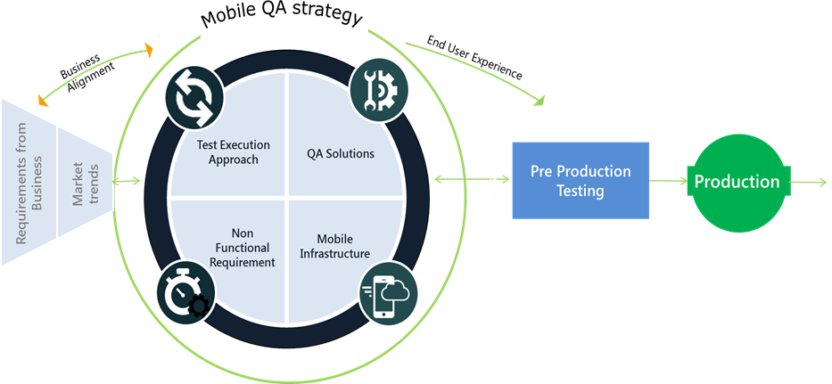

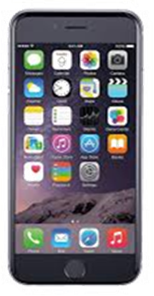



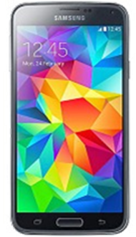
Overall Testing Approach for Hybrid Mobile Application
Execution
GO
LIVE
UAT
Functional Testing,
Compatibility Testing,
Mobile Specific Testing,
Performance Testing
UAT Support
System Testing (Hybrid and RWD)
Functional
Testing
Compatibility Testing
Performance Testing
Mobility Specific Tests
End to End / Integrated
Scenario Testing
System Integration Testing
Compatibility Testing
Performance & UAT Testing
Primary Devices
Secondary Devices
Primary Devices
Primary Devices
Primary Devices

Slide 11



Testing Methodology
Test Control & Management ( Continuous Test Project steering to align/adopt to ongoing changes and also based on metrics collected)
Test Planning
Test Preparation
Test Execution
Test Completion
Test Design & Execution Plan
Smoke Testing
Participation in QA/
Planning Workshops
System Testing
Test Recommendation
Report
Finalize Test Coverage &
Device Selection Strategy
Understand
Requirement
System Integration testing
Finalize testing &
Archive Test Artifacts
Phase Level Activities
Physical Device & Network Setup
Project Milestones/
Resource Planning
OS/Device/Browser Mobile
Compatibility testing
Update Regression Suite
Preparation of Use case
Traceability Matrix
Identify Project Risks/
Mitigation
Cross Browser Testing (Admin Portal)
Update Defect/Test
Management Tools
Review and Approval by
Business SMEs
Mobile NFT (Interrupt, N/W- 3G, 4G)
Performance Testing
Discuss and
Baseline Test plan
Intake of Test
Environment
UAT Support
Deliverables
Test Strategy/ Plan
Product Risk assessment
Test cases document
Use case Traceability matrix
Test Environment Setup/ Environment Intake Report
Test Execution matrix
Test Execution Results with Screenshots
Test Execution Summary ( during execution phase )
Defect Reports summary
Test Recommendation
Reports
Defect Analysis Report

Slide 12
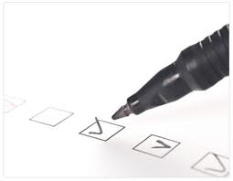
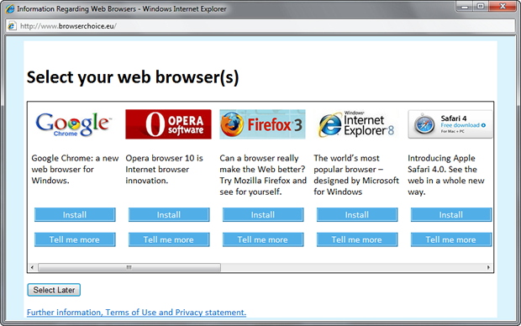



Cross Browser Testing
TEST EXECUTION
Cross Browser Testing
Admin Portal
Requirements Identification
Identify major end-user workflows to be verified
Browser Statistics Analysis
Desktop Browser-OS Combinations
Configuration Selection
Select browser / OS combinations
Browser / OS | Browser Version | OS | % of Test Coverage
IE | 11 | Windows 8 | 100%
Chrome | 58 | Windows 8 | 100%
Firefox | 54 | Windows 8 | 50%
Safari | 10.10 | MacOS | 50%
Test Environment Setup
Prepare test environments based on configuration
Test Execution
Load each web page on different browsers
Verify web pages for correctness
Test end-user workflows
Test Closure
Prepare screenshots for failed scenarios
Analyze defects and prepare Test Report

Slide 13
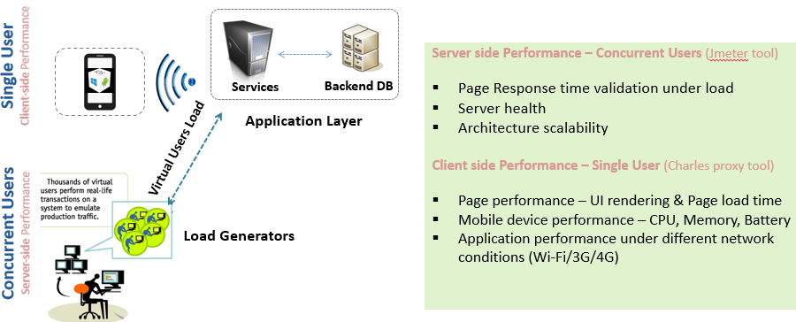
Mobile Performance Testing
Activities
Requirements Analysis Test Plan Preparation
Identify NFRs
Test Scripts Preparation (Multi users scenario)
Reporting
Mobile Performance Testing Execution
Performance test execution (mobile on-device performance analysis) on both iOS and Android platform – Single user
♦This will be done using Charles proxy-
-tool under different network conditions
Performance test execution using JMeter tool – Multi users (150)
Analysis
Carry out detailed analysis on each of the use case and provide observations for the performance hotspots identified
Cognizant will conduct mobile performance testing of Cargill Mobile Hybrid App
Performance Test Tools
Network Analysis / Emulation - Charles Proxy
On-Device Performance Analysis – Browser Plug-ins and Native tools such as XCode and Android Studio
Deliverables
Test Plan
Daily/Weekly Status Reports
Test Closure Report
Performance testing summary deck

Slide 14
Recommended Device Matrix (Testing)
S.No | Device | Device Type | Platform | Operating System | Screen Size | Screen Resolution | Priority | Infra Type | % of Functional Testing
1 | iPhone 6s | Phone | iOS | 10 | 4.7" | 750 x 1334 pixels | Primary | Physical Device | 100%
2 | Samsung Galaxy S6 | Phone | Android | 6,7 | 5.1" | 1440 x 2560 pixels | Primary | Physical Device | 100%
3 | iPhone 5 /5S | Phone | iOS | 8.4.1 | 4.0" | 640 x 1136 pixels | Secondary | Physical Device | 25%
4 | Samsung Galaxy S5 | Phone | Android | 5.0.2 | 5.1" | 1080 x 1920 pixels | Secondary | Physical Device | 25%
NOTE: Mobile Device, Model, OS version are arrived based on sample market stat and proven industry best practices, However this device list can be discussed and updated with both parties ( Cognizant and Customer ) but not increasing the no. of devices . Additional devices would incur additional test effort and device costs.
Test Execution Cycles
Type of Testing | Device Category | No of Devices | % of functional execution | No of execution cycle
System Testing | Primary | 2 | 100% | 1
Device/OS Compatibility Testing | Secondary | 2 | 25% | 1
Mobile Specific Testing (Interruption, Network Testing, Battery Consumption etc) | Primary | 2 | 5% | 1
Defect Retesting | Primary | 2 | 20% | 1
Regression Testing | Primary | 2 | 20% | 1

Slide 15
Assumptions & Dependencies – Application, Portal & Web services development
Mobile App & Admin Portal Development Assumptions
The mobile App will be developed using HTML5, CSS3, JS, jQuery and wrapped as a hybrid mobile app using PhoneGap (Cordova).
Mobiles OS versions assumed for support are iOS9 & above and Android latest 3 versions respectively. The actual devices and OS versions for elaborate testing shall be mutually agreed upon between Cognizant and Cargill during Due Diligence phase
Only Mobile form factor is considered in scope
App will be built to function in Portrait mode only
Mobile App will be designed to support only English
Data will be stored in device local storage (SQLite) in an encrypted format to store limited recipe data. Limited offline functionality to store already viewed policy documents and to store pending data for 7 days is considered
Cargill will procure the required licenses for third party push notification service and provide the same for development and testing
This Admin portal is an RWD app and is built on HTML5, CSS3, jQuery
In-Sprint Functional Tests and Regression tests will be done on Primary and Secondary set of devices. Primary Device Tests include Functional Tests, Defect retesting and End to End Regression. Tests on Secondary devices would focus on User Interface layout and Compatibility as well as 60% of functional test cases to ensure compatibility
The choice of primary and secondary devices shall be made in conjunction with Cargill during initial Discovery Phase, based on the device market share at that point of time.
When user has no data/internet connectivity in devices, farm data entry would be saved in local storage which has the storage capacity for 5MB. It is retrieved as the Pending Data list and it will be saved for 7 days .
Viewed policy document will get download and stored in the phone memory. In offline mode, user will be able to view the downloaded policies. (Storage space is totally based on the user phone memory).
Offline capabilities are considered by enabling the Local storage and based on the phone memory.
Socket.IO jQuery plugin to be leveraged for Chat functionality.

Slide 16
Assumptions & Dependencies – Application, Portal & Web services development
Project-related Assumptions & Dependencies
The effort, timeline & cost numbers are based on the requirements provided. Any Change to the scope of work may impact on effort, timeline and cost. Any scope change and/or new requirement will be managed through the change management process.
All the delivery artifacts would be in English only.
NFRs would be evaluated and agreed to post the initial requirements phase.
All software licenses, tools, images, assets required for the project will be procured by Cargill
Deployment to the Play store, iTunes App store shall be handled by Cargill. Cognizant will provide support as required
Cargill will provide Cognizant with final requirement documentation prior to project start
Cargill SMEs will be available throughout the project for signoffs and for providing clarifications
Availability and Readiness of appropriate environments should be facilitated by Cargill
Brand guidelines, Style guides, Logos, images, unique font types (if any) will be provided by Cargill.
Required connectivity, access and network support to client network
Business/Test data necessary for testing will be provided by Cargill
Cargill should provide Single Point of Contact to prioritize work and provide management support
Timely access to relevant information and infrastructure; documentation, systems and applications should be made available
Timely Signoffs on design Artifacts: In absence of a response within a reasonable time frame of 2 days the respective deliverable will be deemed signed off.
All tool license details (Test Management and Defect Management) to be shared by clients
We assume that the required devices for testing will be provided by the customer

Slide 17
Implementation Plan
The project will kick off with a quick requirement validation phase of 1 week followed by Waterfall model of development – Design, App Development and Testing phases. Go-live shall be achieved within 15 weeks from the start of the engagement.
 | W1 | W2 | W3 | W4 | W5 | W6 | W7 | W8 | W9 | W10 | W11 | W12 | W13 | W14 | W15 | W16 | W17
Discovery Phase
Requirements Gathering & Sign off
Project Planning & Initiation
Solution Design
Execution Phase
Wireframes Creation
Visual Designs Creation
Web Services Development
Mobile App Development
Testing
Performance Testing
UAT Support
Deployment and Go-Live
Warranty Support
= GO LIVE

Slide 18
Thank You

